Slide 1


Final Project Analysis DDS-6306
Ivan Chavez
Notes:
case study 2 data set

Slide 2
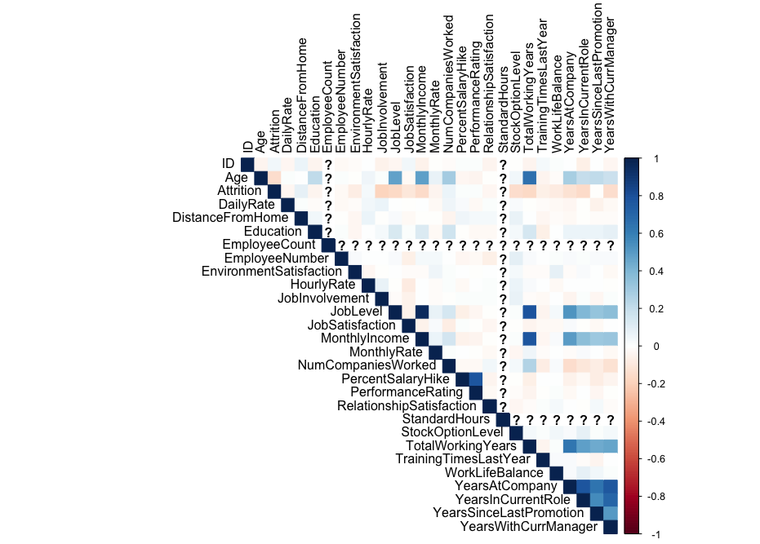
Attrition Analysis
To start my analysis, I wanted to observe the variables and get a better understanding of the dataset and what variables attributed to attrition or had correlations to the attrition values.

Slide 3
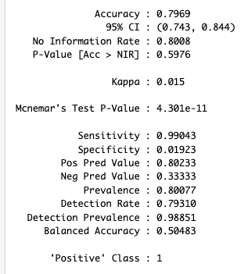
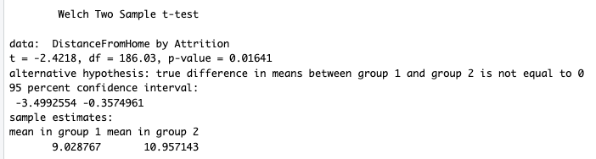
Attrition Analysis Cont.
First KNN Model
T-test for Distance from home compared to attrition
Based off the previous correlation matrix I identified a few values that appeared to be positively correlated to attrition so I built a model around them.
Those variables were Hourly rate, distance from home, and number of companies worked.
After testing though this model wasn’t a good fit since we did have a high sensitivity but the specificity level was low in comparison.
Through t-tests I was able to find the value that had statistical significance in regards to attrition which was distance from home.

Slide 4
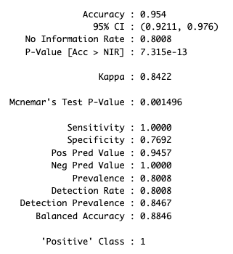
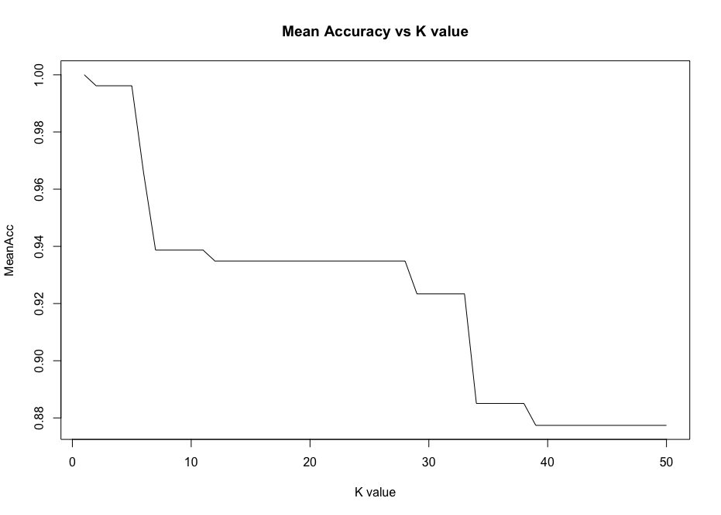
Attrition Analysis Cont.
Second KNN Model
Plot of Mean Acc v K-Value
After looking at the correlation matrix, investigating the variables, and research I decided to add variables that were negatively correlated to attrition to help the model be a better fit and attain the values that we want.
After running the model and creating a oversampled dataset the model performed much better and I was able to attain the desired levels that I wanted.
I used this model to produce the predictions for the no attrition dataset.

Slide 5
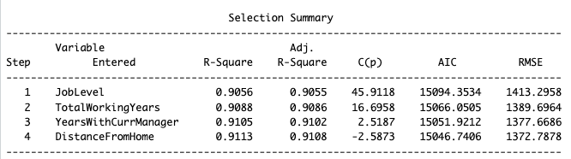
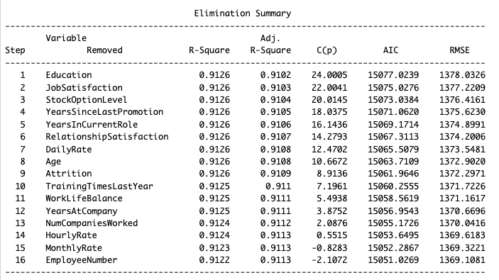
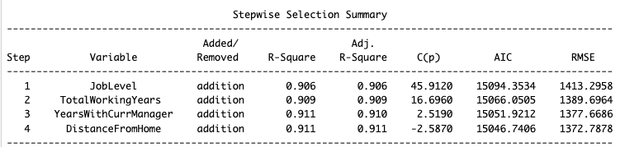
Monthly Income Analysis
Next my goal was to observe the monthly income and obtain a model that would be best in predicting monthly income. So I ran a few variable selections seen below. After running the selection process and observing the values I decided to go with the model that the stepwise and forward variable selection picked.
Forward Selection
Backward Selection
Stepwise Selection

Slide 6
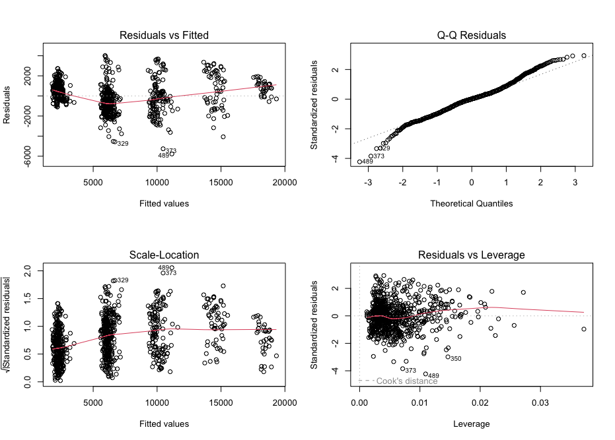
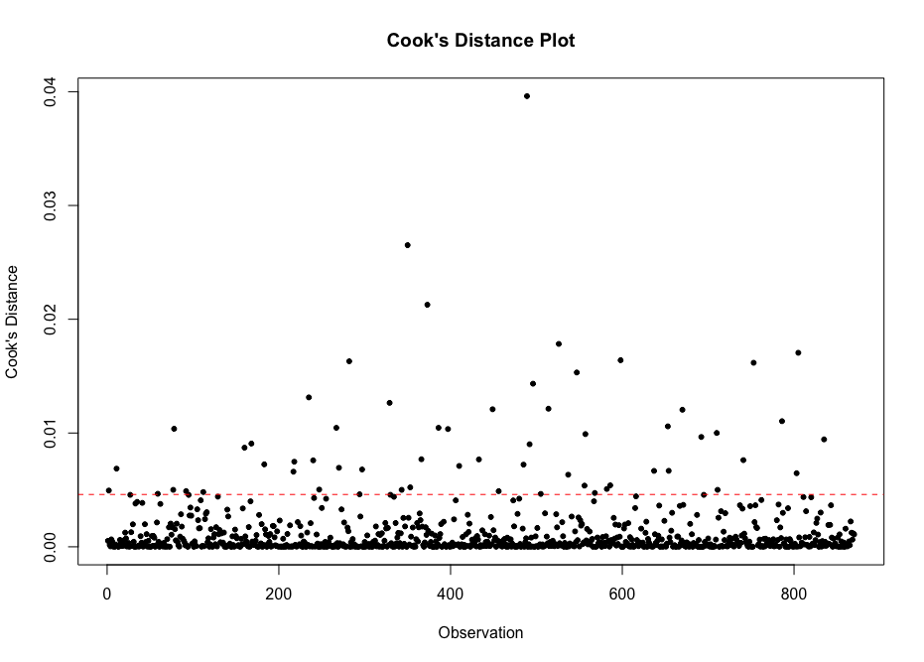
Monthly Income Analysis Cont.
The variables I chose for my multiple linear regression model are monthly income, total working years, years with current manager, and distance from home. This model produced the best values. Below are plots of the residuals and cooks D.

Slide 7
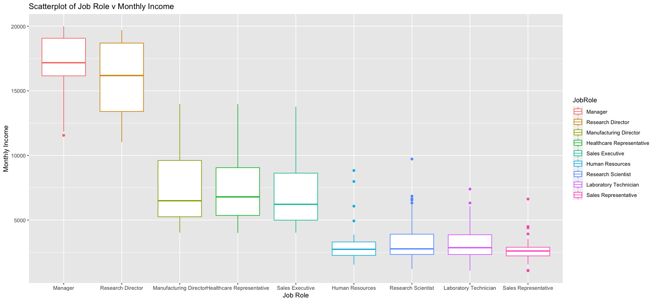
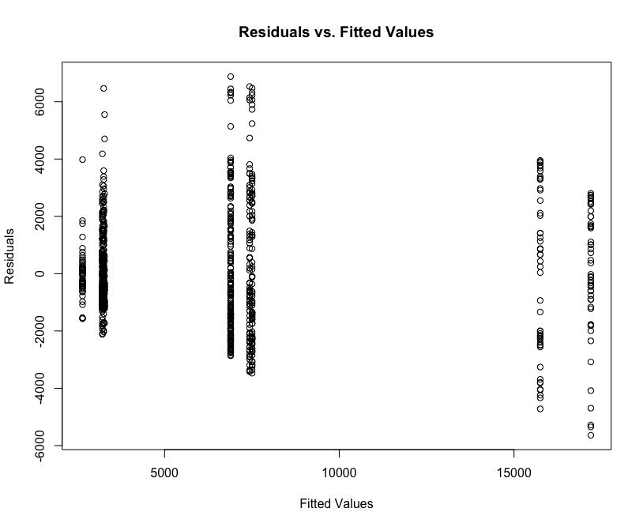


Job Role v Monthly Income
I wanted to see if there were any differences on job role and how that affected the mean monthly income.
I plotted the values in a box plot and ordered them by monthly income.
Additionally, I ran a few tests to see if there were significant differences in the values.
I ran a tukey test as well and those results are in my code and this gives a good idea of how the job roles differ from each other in terms of monthly income.
Anova Test

Slide 8
Conclusion
Found a proper fitting model to predict attrition after experimentation and adding positively and negatively correlated values in terms of attrition. Can predict with a 95% accuracy level whether a employee will be a yes or no to the attrition value.
Through variable selection and working with the dataset attained a well fitting multiple linear regression model where the predictor variables were job level, total working years, current years with manager, and distance from home.
Based off the dataset and testing found that there is a statistically significant difference in one of the groups when it comes to monthly income.

